Slide 1
Function

Slide 2
What is Function?
A function is a self-contained program segment that caries out some specific, well-define task.
Every C program consists of one(at least) or more functions
One of these function must be called main()
Execution of a program always begin by carrying out the instructions in main().

Slide 3
General Form
#include <header file name>
// function prototype here
int main()
{
/*…………*/
}
return-type f1(parameter list)
{
/*………*/
}
return-type f2(parameter list)
{
/*………*/
}
....
return-type fn(parameter list)
{
/*………*/
}

Slide 4
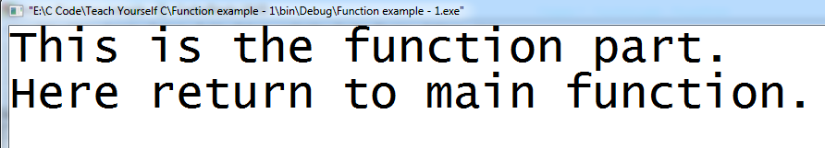
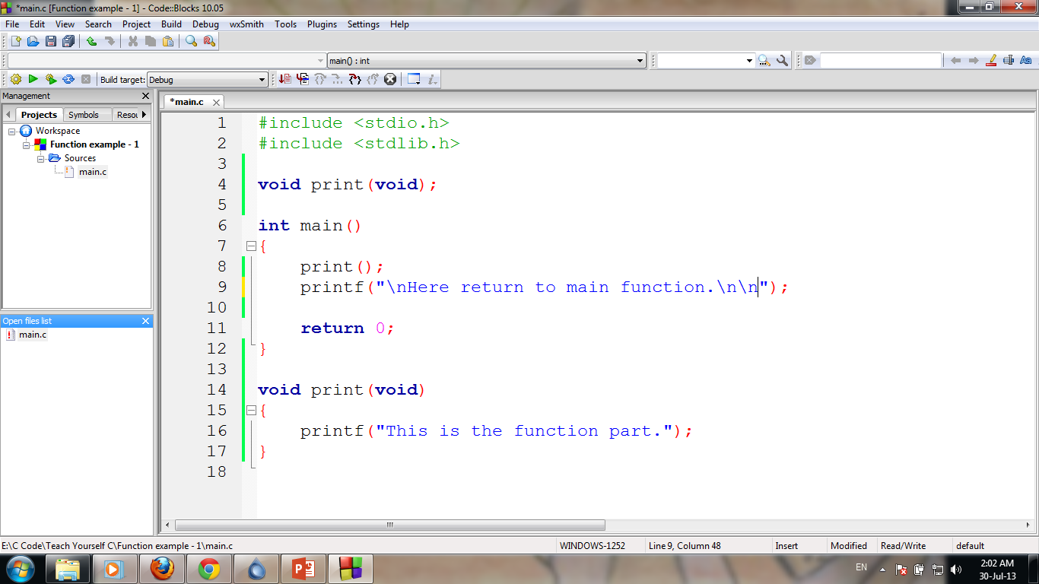
Simple example
Function Prototype
Program

Slide 5
Function General Form
return-type fun-name(type parameter1, type parameter2)
{
/*……function body…*/
}

Slide 6
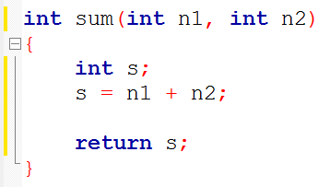
Function General Form
return-type fun-name(type parameter1, type parameter2)
{
/*……function body…*/
}

Slide 7
Function Prototype
return-type fun-name(type parameter1, type parameter2)
{
/*……function body…*/
}
return-type fun-name(type parameter1, type parameter2);

Slide 8
Function Prototype

Slide 9
Function Prototype

Slide 10
Function Prototype

Slide 11
Function of Function Prototype
Declare following attributes associated with a function:
Its return type
The name of its parameters
The type of its parameters
The function name

Slide 12
Function Prototype
A function prototype declares a function before it is used and prior to its definition.
Compiler needs to know this information in order for it to properly execute a call to function.
main() does not need prototype.

Slide 13
Argument and Parameter
A function’s argument is a value that is passed to the function when the function is called.
A function can have zero to several argument.

Slide 14
Argument and Parameter
For function to be able to take arguments, special variables to receive argument values must be declared, called parameter of the function.
The parameters are declared between the parentheses that follow the function’s name during function definition.

Slide 15
Function Call
We can accessed a function by specifying its name, followed by a list of arguments enclosed in parentheses and separated by commas.
If the function call does not require any arguments, an empty pair of parentheses must follow the name of the function.

Slide 16
Function Call
A function will carry out tis intended action whenever it is accessed (called) from some other portion of the program.
Once the function has carried out its intended action (end of that function is reached), control will be returned to the point from which the function was accessed.
Traditionally, main function is not called by any other function, but there is no technical restriction.

Slide 17
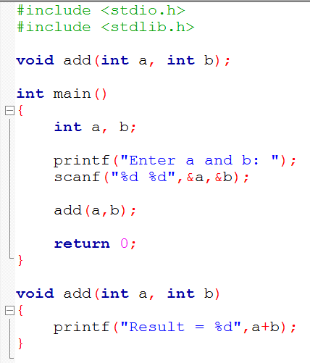
The function call
1
2
3
Function Call
4
5
Finish!
9
10
6
Start the called function execution
7
8
End of Function

Slide 18
Declaration vs Definition
A declaration specifies the type of an object.
A definition causes storage for an object to be created
In function-
prototype is declaration
the function itself, which contain the body of the function is a definition
define a function prior to its first use – no prototype

Slide 19
Local vs Global : Def.
Variables that are declared inside a function or block are local variables.
Global variables are defined outside of all the functions, usually on top of the program.

Slide 20
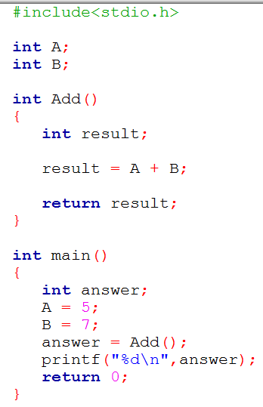
Local vs Global : Example

Slide 21
Local Variable Scope
Local variables can be used only by statements that are inside that function, for which it is local.
Local variables are created when a function is called and they are destroyed when the function is exited.
Local variables are not known to functions outside their own.

Slide 22
Local Variable Scope…
Local variable of one function have no relation to the local variable in another function.
Several functions can have local variables with same name(s) but have no relation with one another.
Formal Parameters are also local variable to that function.

Slide 23
Global Variable Scope
Global variables are exist the entire time our program is executing.
Global variables may be accessed by any function in our program.
Hold their value during the entire execution of the program.

Slide 24
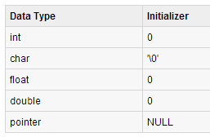
Local vs Global : Initialization
When a local variable is defined, it is not initialized by the system, you must initialize it yourself.
Global variables are initialized automatically by the system when you define them as follows:

Slide 25
Understand Recursion!
Recursion is the process by which something is defined in terms of itself.
In function – Recursion is a process by which a function calls itself repeatedly, until some specified condition has been satisfied.
The process is used for repetitive computations in which each action is stated in terms of a previous result.

Slide 26
Recursion…
In order to solve a problem recursively, two conditions must be satisfied.
the problem must be written in a recursive form
the problem include a stopping condition

Slide 27
Example - factorial
5! = 5x4x3x2x1
n! = nx(n-1)x(n-2)x…..2x1
Using for loop
again, 5 = 5x4x3x2x1 = 5x(4x3x2x1)
= 5x4! = 5x4x3! = 5x4x3x2! = 5x4x3x2x1
that is n! = nx(n-1)! Recursion!!!
Using recursion

Slide 28
Recursion..
In recursion, no multiple copies of the recursive function will create. Only one copy exist.
When a function is called, storage for its parameters and local data are allocated on the stack.
Thus, when a function is called recursively, the function begins executing with a new set of parameter and local variables, but the function code remain same.

Slide 29
How recursion actually work
return (n*factorial(n-1));
n! = n*(n-1)!
(n-1)! = (n-1)*(n-2)!
(n-2)! = (n-2)*(n-3)!
………………
………………
4! = 4*3!
3! = 3*2!
2! = 2*1
2! = 2*1
3! = 3*2!
4! = 4*3!
………………
………………
(n-2)! = (n-2)*(n-3)!
(n-1)! = (n-1)*(n-2)!
n! = n*(n-1)!

Slide 30
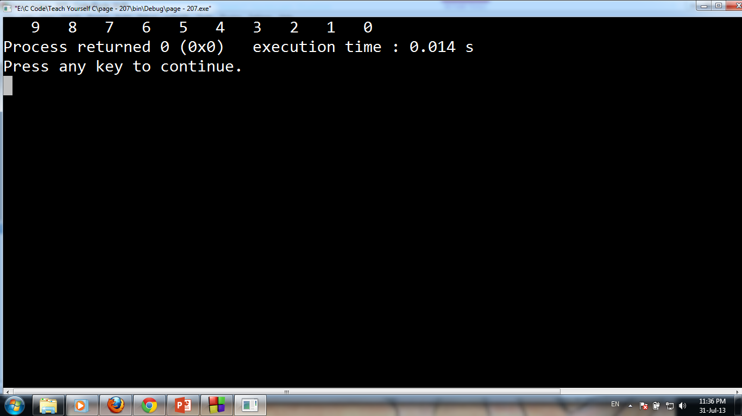
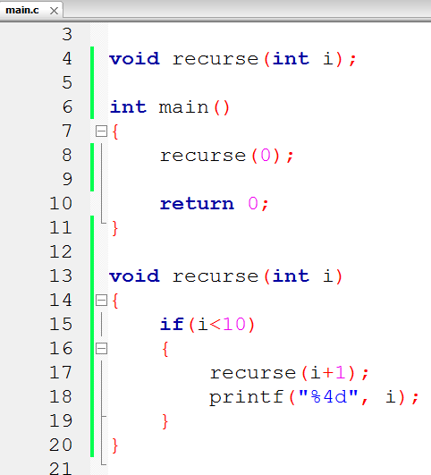

Slide 31
Home Task
Write a recursive function that will copy a string to another. You can’t use strcpy function.

Slide 32
A Closer Look at Parameters
We can pass arguments to functions in two way
Call by value
Call by referance

Slide 33
Call by value
This method copies the value of an argument into the formal parameter of the subroutine (function).
The change made to a parameter of the subroutine have to no effect on the argument used to call it.
Default method to call a function

Slide 34
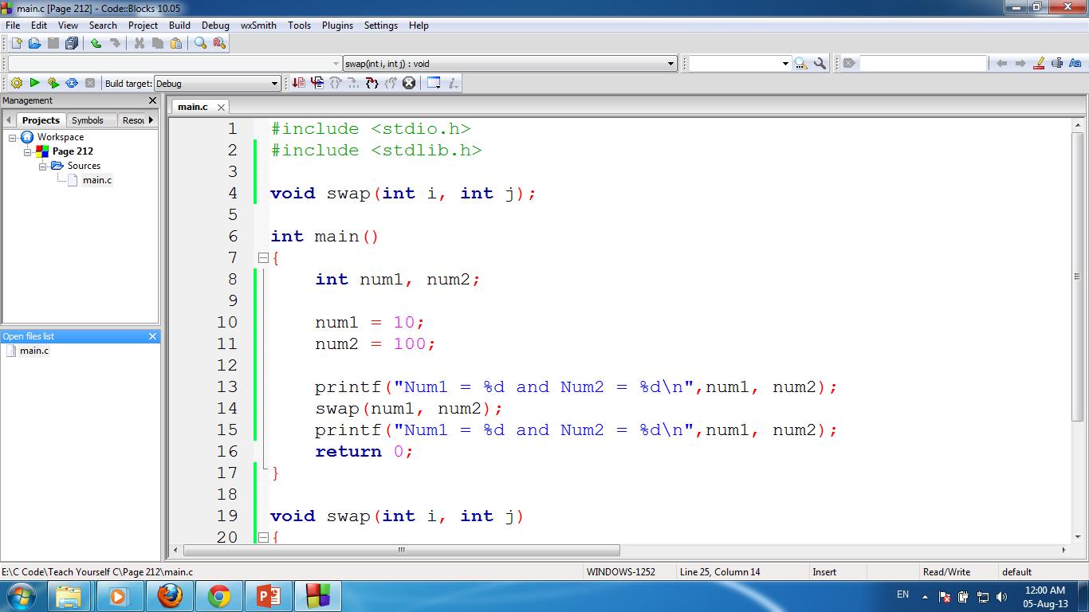
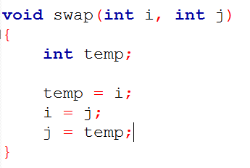
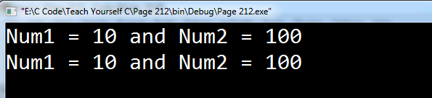

Slide 35
Call by reference
In this method, the address of an argument is copied into the parameter.
Should use pointer
Inside the subroutine, the address is used to access the actual argument.
This means the change made to the parameter will affect the argument.

Slide 36
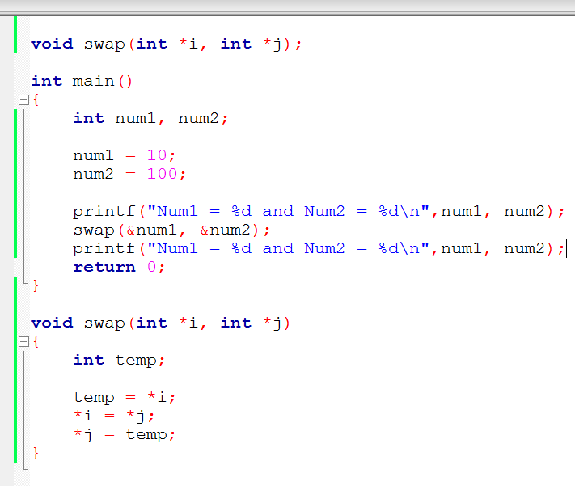
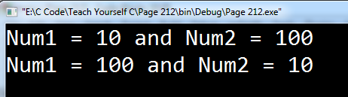

Slide 37
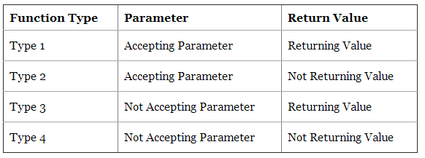
More!
There are five types of functions and they are:
Functions with no arguments and no return values.
Functions with arguments and no return values.
Functions with arguments and return values.
Functions that return multiple values.
Functions with no arguments and return values.

Slide 38
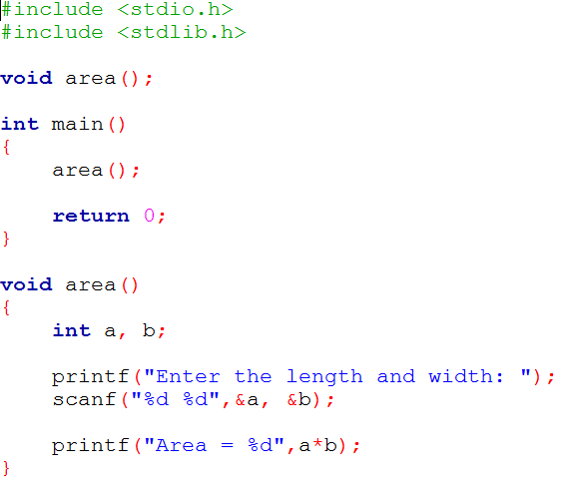
Functions with no arguments and no return values

Slide 39
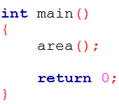
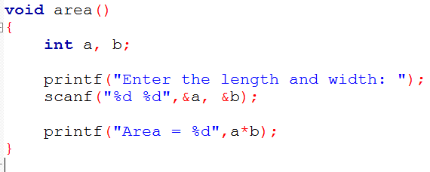
Functions with no arguments and no return values
Control Pass
No argument passing
No return value
Control Pass
Calling Function
Called Function

Slide 40
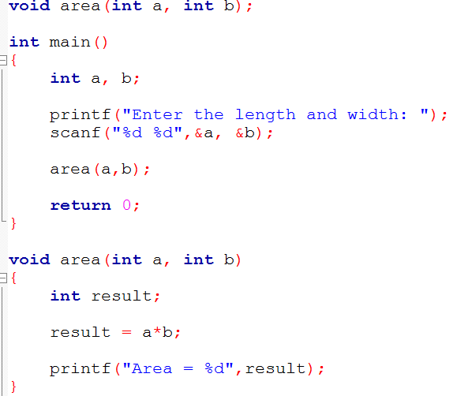
Functions with arguments and no return values

Slide 41
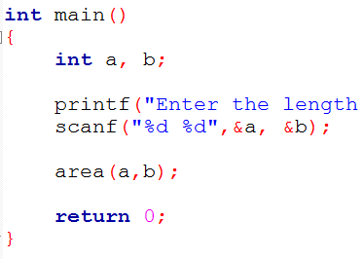
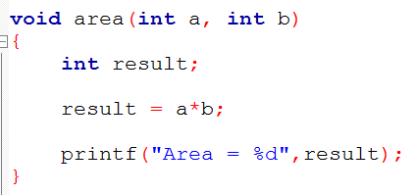
Functions with arguments and no return values
Control Pass
argument passing (a,b)
No return value
Control Pass
Calling Function
Called Function

Slide 42
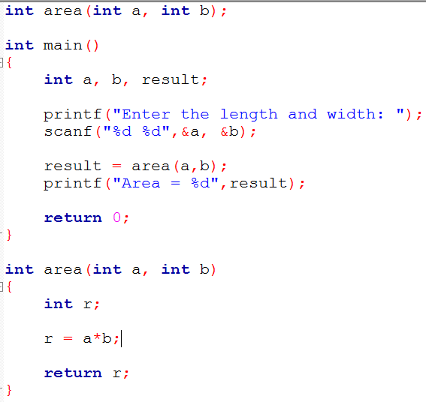
Functions with arguments and return values

Slide 43
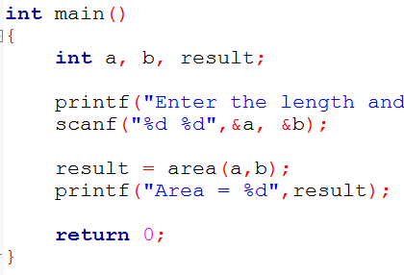
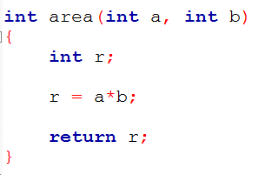
Functions with arguments and return values
Control Pass
argument passing (a,b)
return value r
Control Pass
Calling Function
Called Function

Slide 44
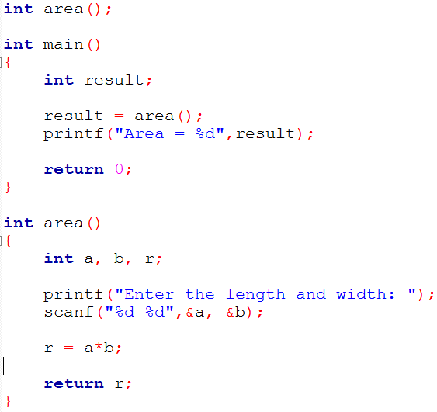
Functions with no arguments and return values

Slide 45
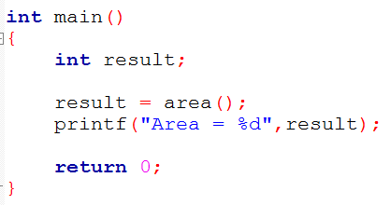
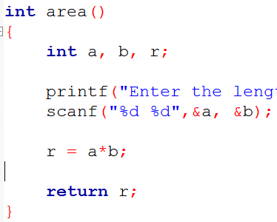
Functions with no arguments and return values
Control Pass
no argument passing
return value r
Control Pass
Calling Function
Called Function

Slide 46
Functions that return multiple values
Method 1 : Using Array
If more than two variables of same type is to be returned then we can use array .
Store each and every value to be returned in an array and return base address of that array.
Method 2 : Using Pointer and One Return Statement
Pointer Variable can updated directly using Value at ['*'] Operator.
Usually Function can return single value.
If we need to return more than two variables then update 1 variable directly using pointer and return second variable using ‘return Statement‘. [ Call by Value + Call by Reference ]
Method 3 : Using Structure
Construct a Structure containing values to be returned and then return the base address of the structure to the calling function.

Slide 47
Pass argument to main()

